Slide 1
Headquarters: New Lenox, IL

Slide 2
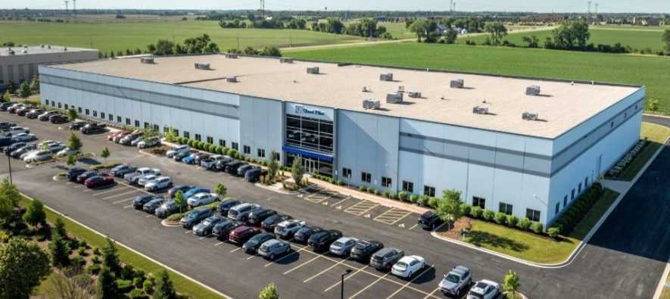
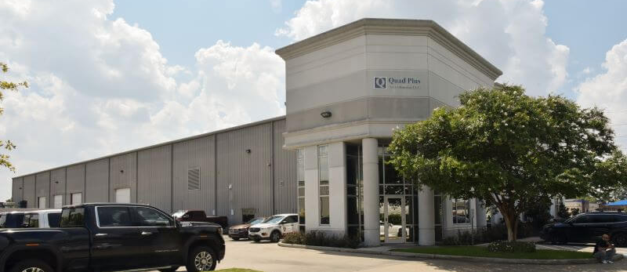
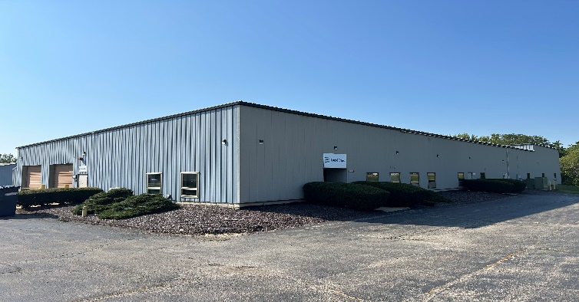
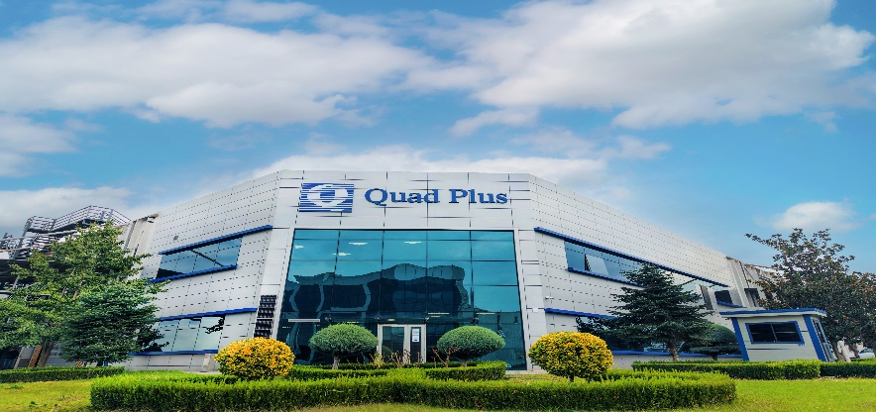
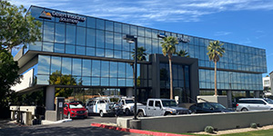
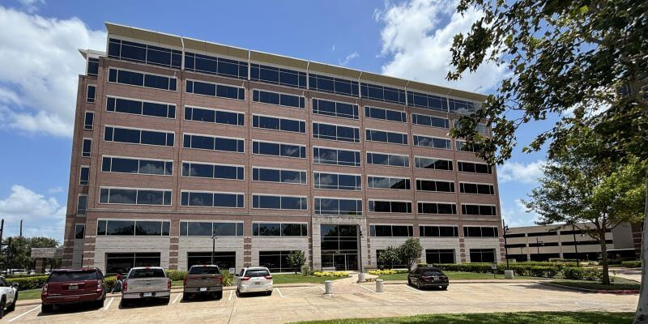
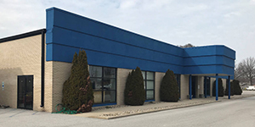
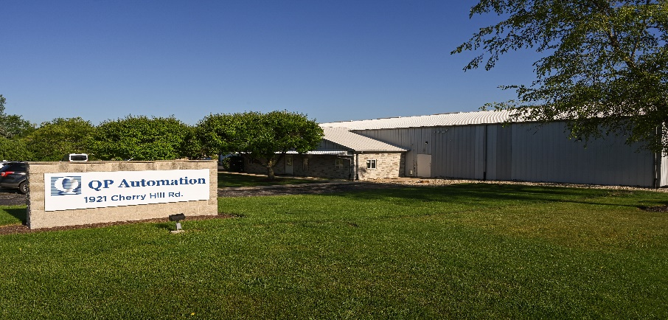
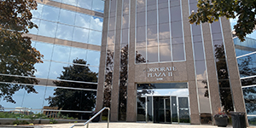
Quad Plus Facilities

Slide 3
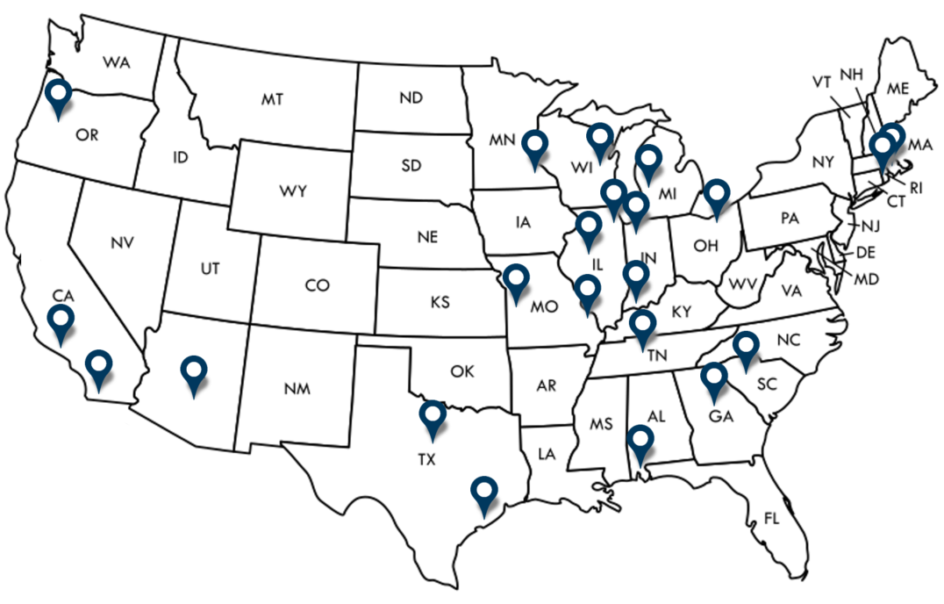

Strategically Located
    Strategically Located
    Illinois / Chicagoland
      Licensed Professional Engineering
      Machine Safety
      Industrial Automation & Commissioning
      Auto Shredding & Large Drives
      NETA Electrical Power Testing
      Power Studies
      AC / DC Drive Repair
      Circuit Breaker Repair / Reconditioning
      Parts Distributor
    Texas
      Oil, Gas & Marine Integration & Manufacturing
      Drive Repair
      Power Services
    Bursa, Turkey
      Industrial Automation
    Pune, India (Engineering)
  $200 Million+ Annual Sales
    Total Personnel – 300+
    U.S. based Engineers – 90+

Slide 4
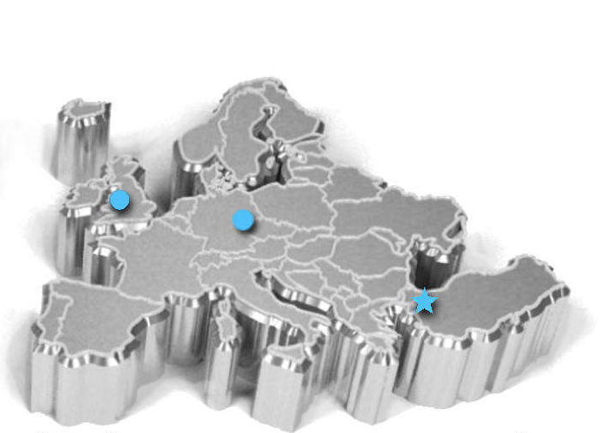
International Locations
Our International Locations
  England - Sales Office
    Industrial System Automation and Auto Shredding
  Bursa, Turkey
    Industrial System Automation
    25,000 sq/ft manufacturing facility
  Pune, India
    Professional Engineering

Slide 5
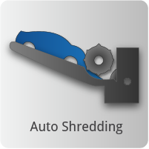
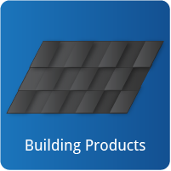

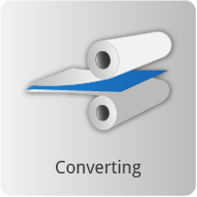
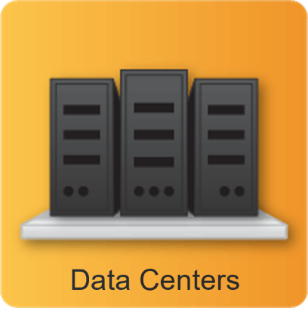
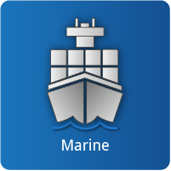
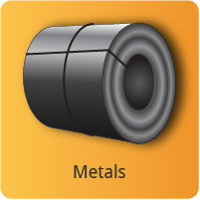
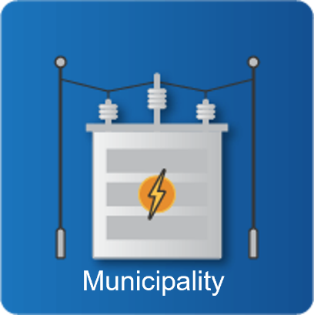
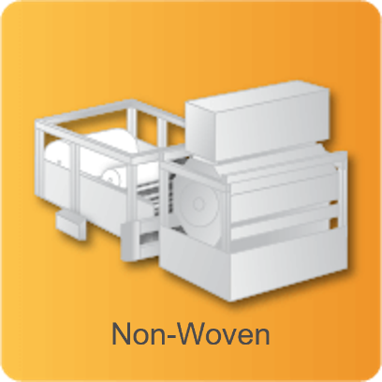


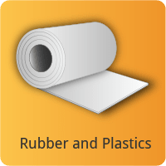
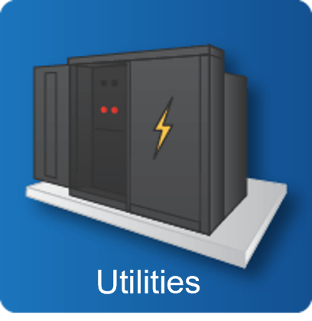
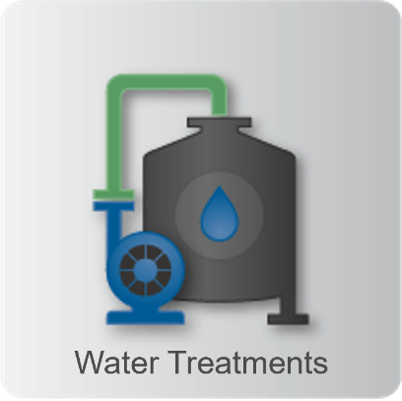
Industries We Serve

Slide 6
Our Certifications
Quality Standards Certifications
Licensed Professional Engineers on Staff
ISO 9001 Manufacturing Locations
UL 508A
UL 698A
UL 1203
CE Certified
Authorized Solution Provider for:
Siemens Solution Provider Automation and Drives
Rockwell System Integrator
Rockwell Solution Provider Automation and Drives – QPEU
Siemens System Integrator – QPEU
Control Techniques, USA National System Integrator
ABB Value Provider & Crane Certified
Wonderware Archestra Certified
Inductive (Ignition) Automation Certified Integrator
Safety Standards Certifications
TUV Rheinland Certified Safety
TUV SUD Certified Safety
Siemens Certified Safety Professionals
Repair Certifications
Siemens AG Certified Repair – Specific Products
PEARL Certified – Circuit Breakers
NETA Certification – Electrical Testing
Control Techniques, USA Certified Repair Center
Microsoft Partner
HPE OEM
ABB accredited Drive Repair Partner
Siemens accredited Drive Repair Partner

Slide 7
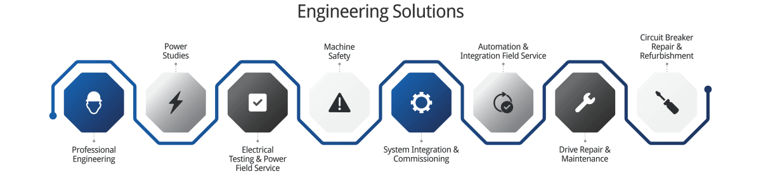
For more details about a specific service, please click on the service box below:

Slide 8
Professional Engineering
Return to Services Page

Slide 9
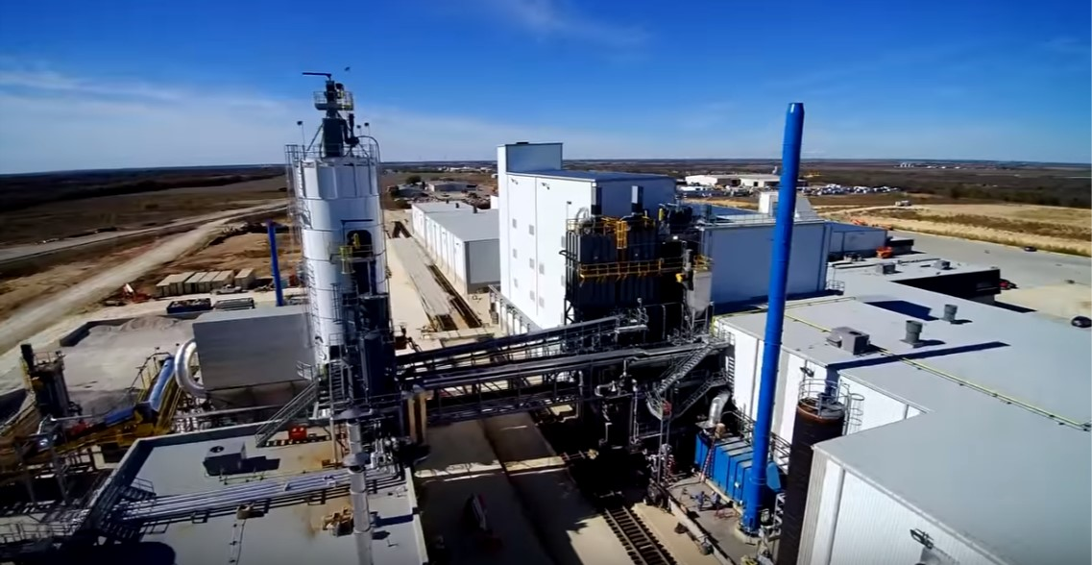
Professional Engineering
We are licensed as:
  Mechanical & Piping
  Civil & Structural
  Electrical & Controls
  Process Piping
  HVAC
Industrial Engineering Services
  Better productivity
  Meet quality targets
  Greater overall success
Technical Services
  Engineering
  Installation
  Design & Build
  Automation
  Project Coordination
  Power Studies
  Remediation and Assessment Services

Slide 10
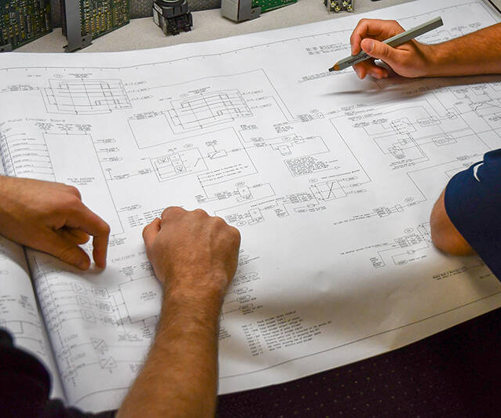
Professional Engineering Disciplines
Mechanical & Piping
  Design & Analyze
  Manufacture & Maintain
  Cost control
  Progress reporting
Civil & Structural
  Stormwater design
  Structural steel design
  Shallow and deep foundation design
  Manufacturing building design
  Site development
  Procurement of trade contract bids and bid evaluations
  Raw material and finished product warehouse design

Slide 11
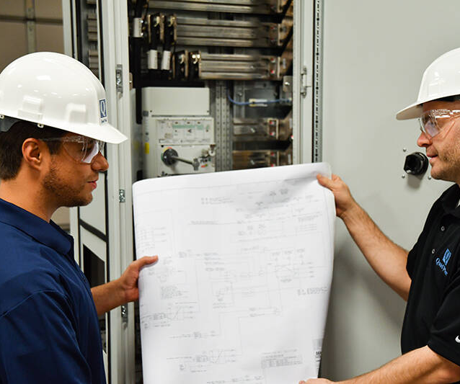
Professional Engineering Disciplines
Electrical & Controls
  Feasibility studies
  Utility investigations
  Reports
  Engineering
  Design
  Distribution
  Electrical design
  Arc flash analysis
  Power studies
  Harmonics studies
  Remediation & Assessment
  Provide detailed engineering and specifications
  Lead negotiations with utility companies
  Procurement of equipment
Return to Services Page

Slide 12
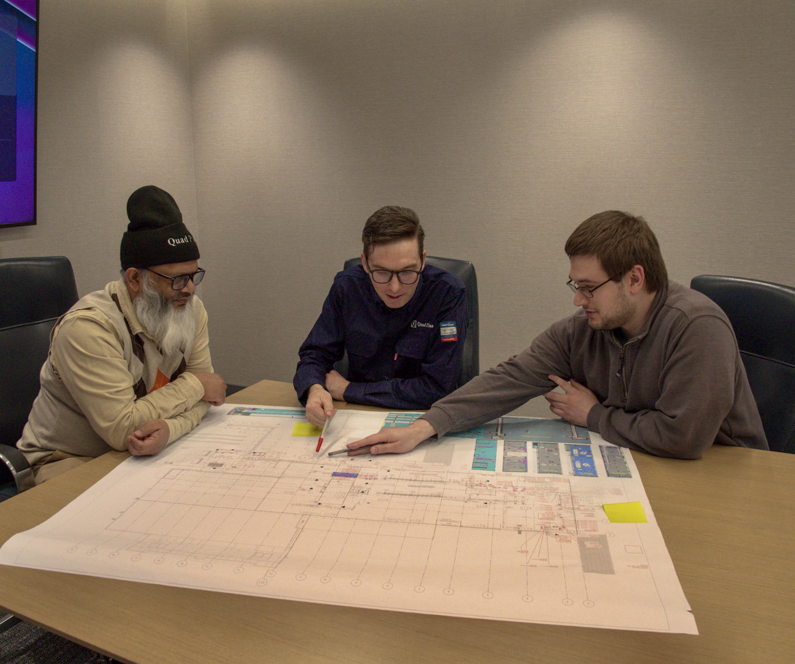
Power Studies and Analysis
Quad Plus offers standard and specialized power system studies along with pre- and post-installation power quality audits to precisely target and correct power issues.
These studies help optimize your power systems’ performance and improve safety.
  Arc Flash Hazard Analysis
  Coordination Studies
  Ground Grid Analysis
  Harmonics and Flicker Analysis
  Load Flow Studies
  Power Factor Correction Studies
  Short Circuit Studies
  Transient Motor Starting Analysis

Slide 13
Machine Safety
Return to Services Page

Slide 14
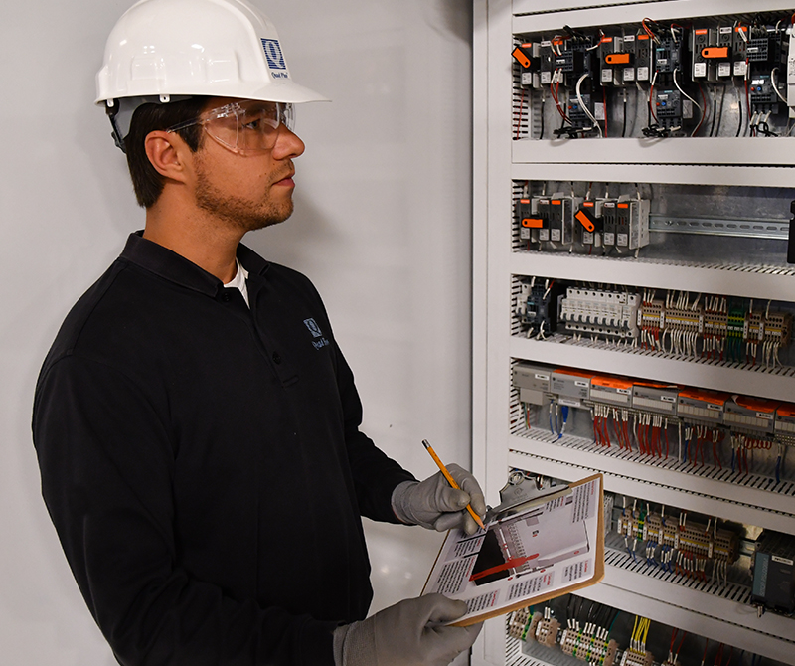
Industrial Machine Safety Consulting
Three-step Safety Review:
  Risk assessment
  Creation of a risk mitigation plan
  Testing and Validation
Performed by TÜV-certified engineers
Complying with domestic and international standards
Extensive experience working with OSHA, ANSI, ISO, and IEC standards
A Comprehensive Safety Review will:
  Show due diligence on your part
  Serve as an important element of a legal defense in the unfortunate event of a mishap

Slide 15
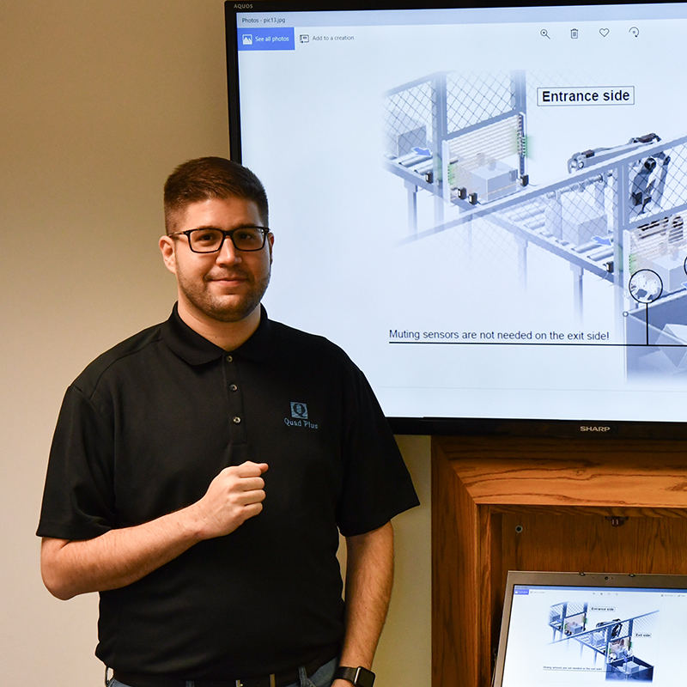
Risk Assessment
Risk Assessment
  Prevent future problems
  Performed before upgrades, for new line installations, before retrofits, or after accidents
  Proactive effort so safety never negatively impacts productivity
  Peer Review (ANSI B 11 & ISO 12100)
    Established to provide a multi-disciplinary team that can review each potential hazard from several angles and will assign a required Safety Integrity Level (SIL) to score each of these areas so that the risks can be correctly mitigated
  Compile a document that will serve as a roadmap for the rest of the Risk Mitigation process

Slide 16
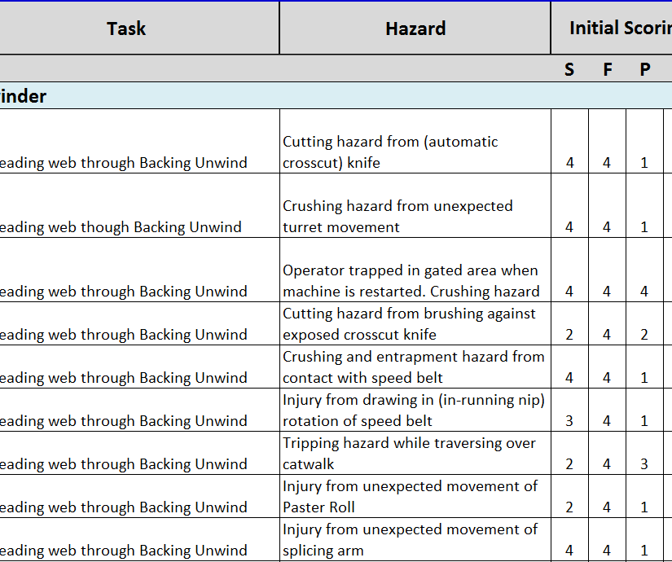
Risk Mitigation
Risk Mitigation
  Develop a specific action plan
  Create hazard maps
  Risk mitigation strategies for each identified hazard
  Assist in developing muting zones
  Generate truth tables and functional descriptions
  Helps engineers correctly program the safety PLC
  Proper use of engineered control solutions can even allow for the replacement of LOTO procedures with muting zones
  Minimize the risk of likely human errors, hardware failures, and environmental and operational stresses
  Compile, Document and Score each defined safety mitigation
  IEC 62061 – SIL Scoring (Scoring available as Category and Performance Level){PL}
  IEC 61508 & IEC 61511 – Mitigation Strategies

Slide 17
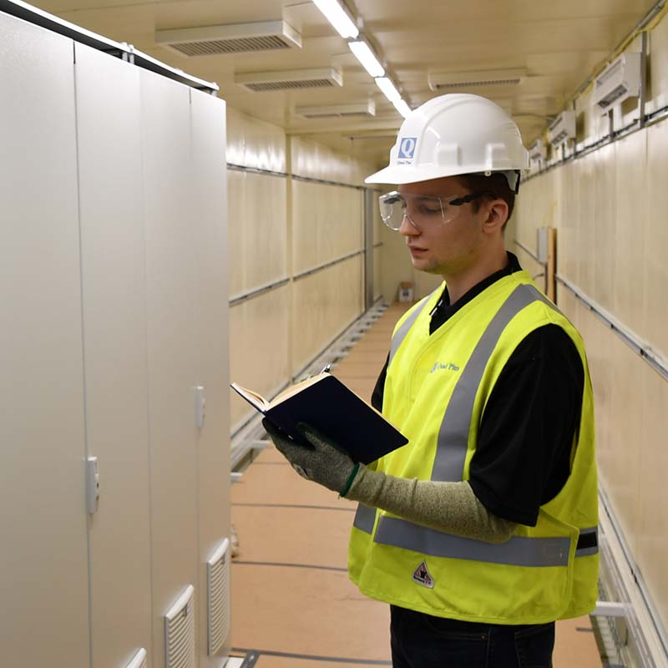
Safety Validation
On-site performance of a step-by-step validation of hardware and functional safety
  Intended performance decided upon during the Risk Mitigation process
  Physically testing machine state and ensuring that the expected outcomes are observed
  Upon failure, the process is started over until all points pass validation
  Active optoelectronic protective devices (Light Curtains, Area Scanners, etc.) will be individually validated
  Final peer review
  Testing and validation audits to prevent unauthorized programming changes
  Test and Validation Audit of the installed and programmed safety mitigations
  ISO 13849-2
Return to Services Page

Slide 18
Power Services
Return to Services Page

Slide 19
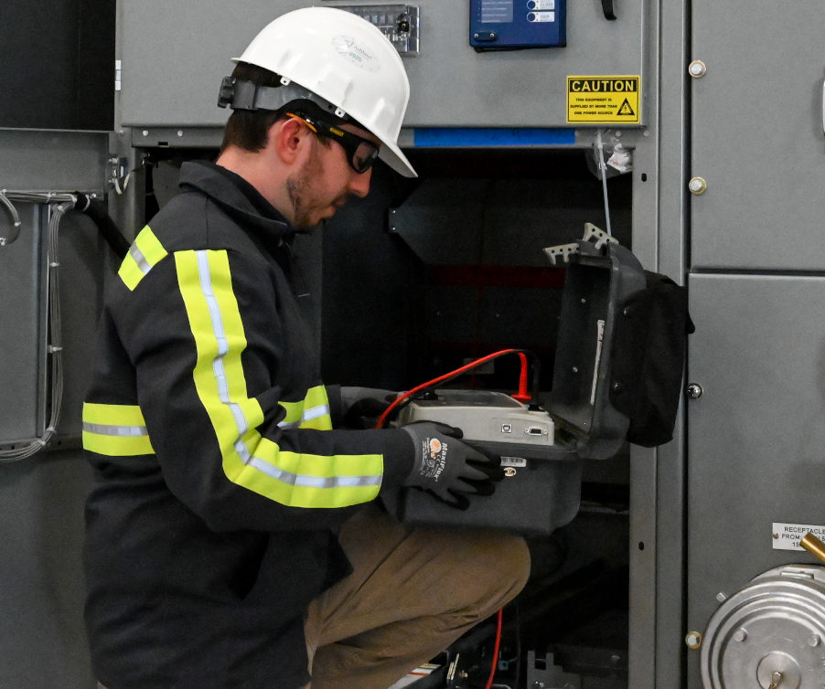
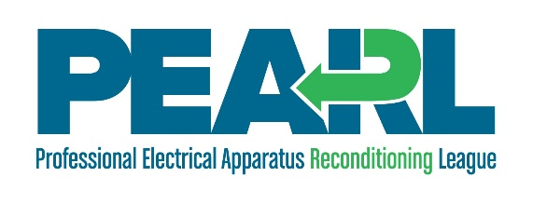

Acceptance Testing
Quad Plus Testing can perform a thorough examination of your electrical equipment following installation and wiring into your power system and make sure all equipment, switches, and connections pass the grade for safe installation and operation.
Quad Plus Testing provides quick and accurate turnarounds on our test reports to ensure no project gets delayed.
Electrical Acceptance Test results can be used as a baseline for future maintenance.
Transformers
Circuit Breakers
Cables
Busway
Switchgear
Protective Relays
Battery Testing
Generator/Motor Meter Testing
Switches
Infrared Scans/Surveys
Power Quality Analysis
Short Circuit Studies
Coordination Studies
Arc-Flash Studies
Exercise/Cleaning Equipment
Testing and Replacement
Visual & Mechanical Inspections of Hardware

Slide 20
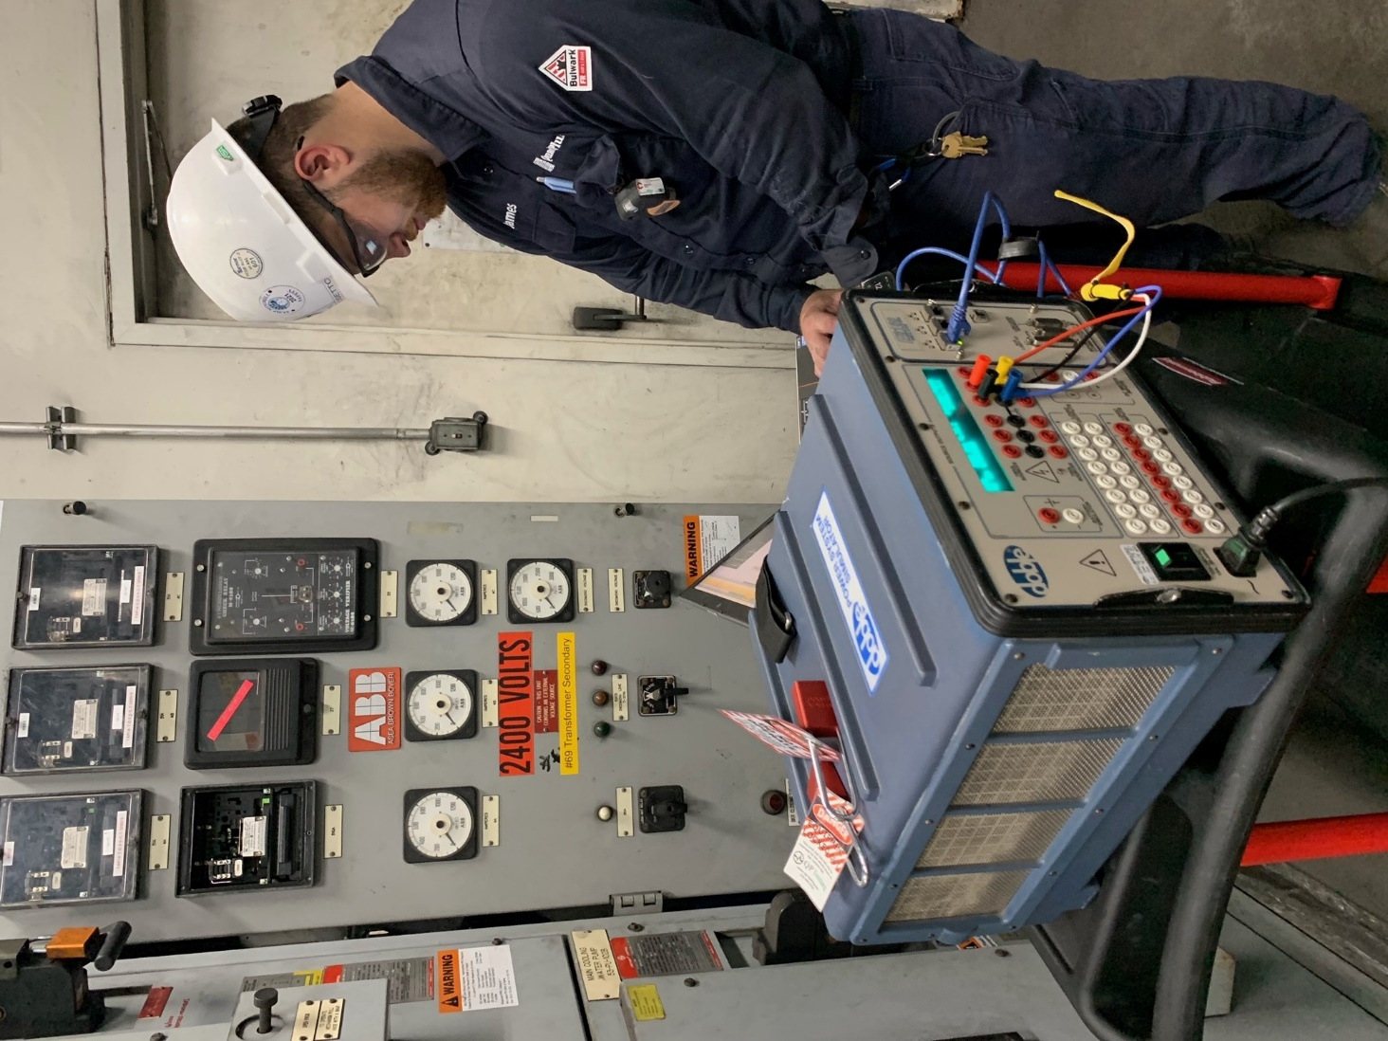
Commissioning Testing
The start-up of your new electrical power system is a unique occurrence and could expose both new and existing problems with the system.
Commissioning by our NETA-accredited professionals through whole system functional checks will ensure proper operation, identify installation problems, and assure you of total power system performance.
Our technicians can provide a wide variety of commissioning support, including, but not limited to:
  Infrared Scans/Surveys
  Hot Checks
  Settings Checks
  Power Quality analysis
  Go-live Support

Slide 21
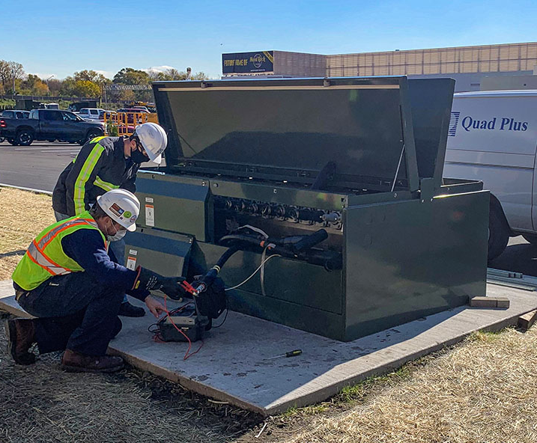
Maintenance Testing
Proper maintenance will ensure the ongoing operation of your equipment and the safety of your crew by identifying and eliminating problems before they develop into serious repairs and costly downtime.
Quad Plus Testing experts can provide recommendations on the electrical equipment. We will provide a periodic maintenance schedule and will perform quarterly, semi-annual, annual, and tri-annual maintenance.
Maintenance Testing ranges up to 345kV:
  Transformer Testing
  Cable Testing
  Circuit Breaker Testing
  Incoming Switch Testing
  Protective Relay Testing and Replacement
  Battery Testing
  Generator/Motor Testing
  IR Scans
  Visual & Mechanical Inspections/Checking Hardware
  Exercise/Cleaning

Slide 22
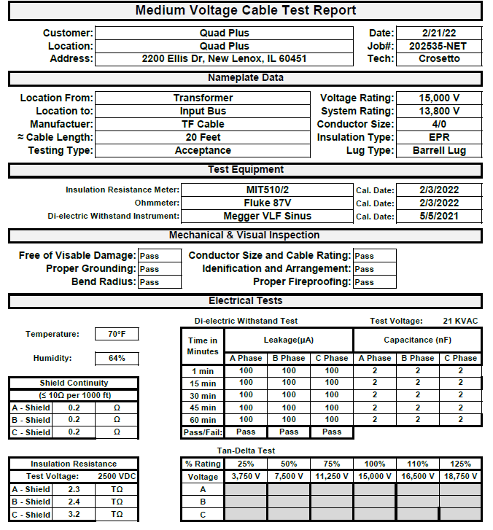
Issuing The Final Test Report
The Final Test Report Identifies:
  The equipment tested
  The test results on official test reports (see picture of failed equipment)
  Preventive maintenance recommendations
  A listing of failed equipment
  A listing of equipment that requires attention or investigation
  Pictures of the equipment with major concerns
The purpose of issuing the report:
  The customers can easily identify which equipment needs to be serviced or replaced and then put that service work into their budgets.

Slide 23
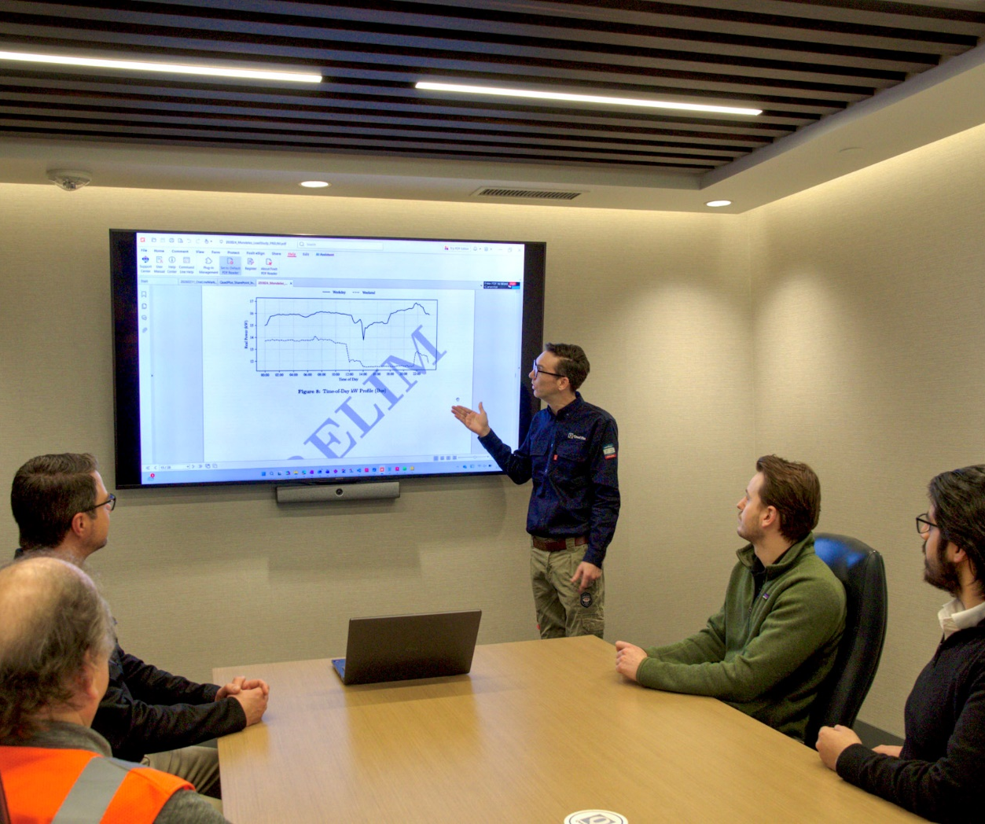
Power Studies and Analysis
Quad Plus offers standard and specialized power system studies along with pre- and post-installation power quality audits to precisely target and correct power issues.
These studies help optimize your power systems’ performance and improve safety.
  Arc Flash Hazard Analysis
  Coordination Studies
  Ground Grid Analysis
  Harmonics and Flicker Analysis
  Load Flow Studies
  Power Factor Correction Studies
  Short Circuit Studies
  Transient Motor Starting Analysis

Slide 24
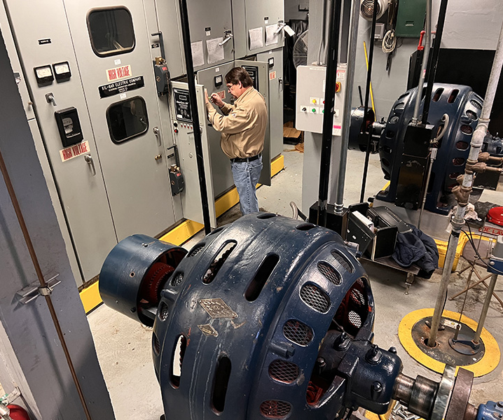
Synchronous Motor Controller Retrofits
A regular maintenance program will allow synchronous motors controllers to continue running for many years
To get the longest possible working life from your synchronous motor and controls means regular replacement of controls, relays, and DC contactors. For machine controls that are obsolete and no longer supported by the manufacturer, this becomes increasingly difficult every year.
You need a partner with an extensive network to source parts for obsolete machines and a crew with the right experience to perform repairs, including retrofitting synchronous motor controllers with state-of-the-art field control when replacement parts are no longer available.
To stay ahead of your competitors, it pays to implement innovations that go beyond simply replacing parts. We design and build each system with top-of-the-line technology. For example, a power factor regulator is configured into all our synchronous systems as an industry standard.
We have installed more than 65 synchronous motor controllers and are happy to supply references from major companies to demonstrate our performance.

Slide 25

Power Company Experts
Power Company Experts
  Work directly with the Power Company on the client's behalf
  We know what is required to get site approvals
Electrical Infrastructure Design
  Low, medium, and high voltage
  Coordinating between the electrical service entrance and customer-owned equipment
    Load forms
    Connection requirements
    Sizing and specifications
Return to Services Page

Slide 26
System Integration & Commissioning
(includes Web Gauging & O2E)
Return to Services Page

Slide 27
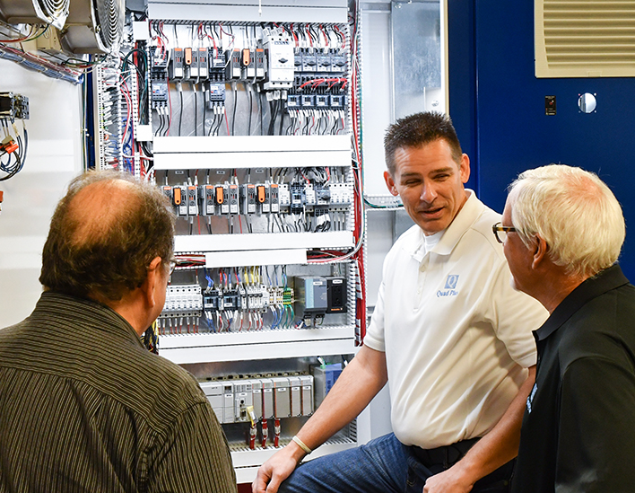

System Integration
Quad Plus is a full-service electrical and automation system integrator for your manufacturing process. We deliver the resources needed for new installations in large-scale industrial processes and for retrofitting viable legacy machinery*
As a turnkey single point of contact, we coordinate all project phases to provide a fully-integrated solution from design to development, implementation, and commissioning.
  We have experience with material handling and processing (continuous and discreet), and our background with a variety of applications provides better insight into your needs and constraints.
  We work with all major original equipment manufacturers to build comprehensive solutions tailored to solve your system challenges.
  Our expert engineers can tackle every processing application, including:
    web tension control,
    stacking and de-stacking
    alignment and orientation detection and correction
    recipe-based batching and coatings application
    air handling
* When obsolete or unrepairable components mandate updates, Quad Plus can evaluate your assets to provide a retrofit option, often while avoiding the need to replace equipment entirely. (page 34)

Slide 28
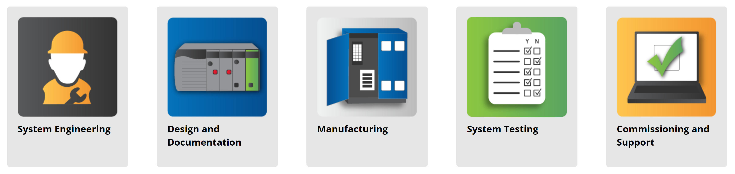
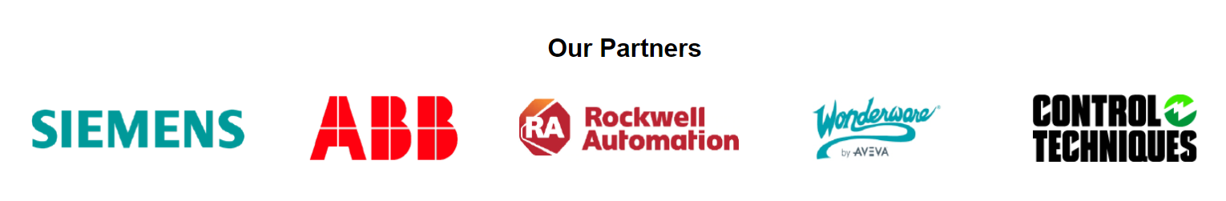
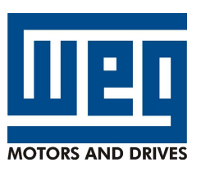
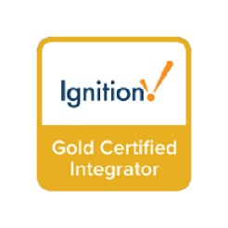
System Integration
We know your system and are experts in your industry!
We work with all major equipment suppliers to build comprehensive solutions tailored to solve your system challenges.

Slide 29
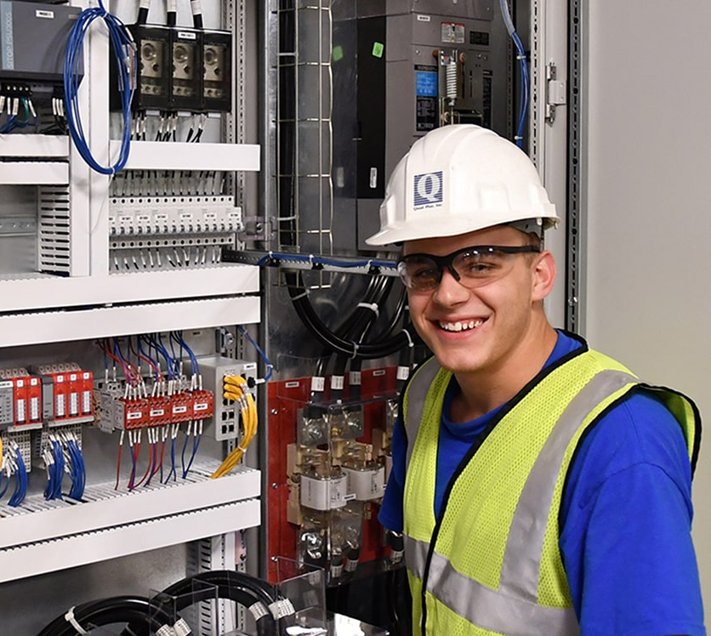
System Engineering
System Engineering
  Our engineers know how to program the system.
  The same engineers who initially meet with the customer to learn what needs to be done also build the BOM, pick out the hardware design, and program the system.
  Our application solution capabilities are vast, including but not limited to the following core areas:
    Coordinated Drive & Automation Systems
    PLC, HMI & SCADA Automation Solutions
    AC Common Buss Coordinated Process Lines
    Regenerative Drive Systems
    Motion Control Systems
    Medium Voltage Systems

Slide 30
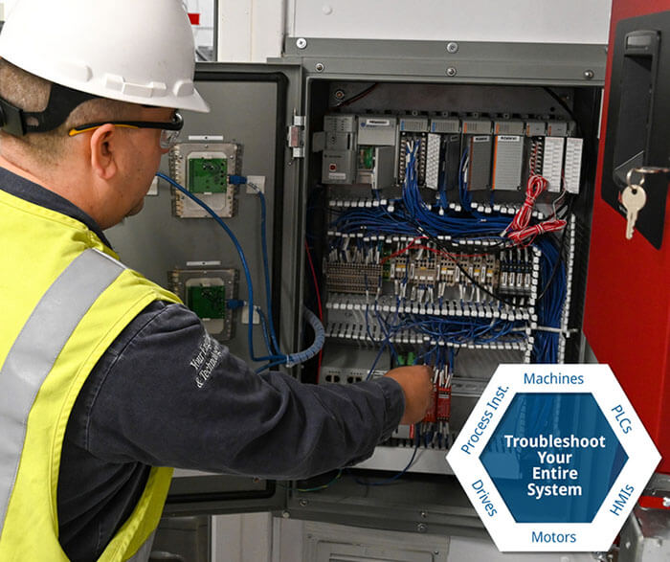
Hardware Engineering
Hardware Engineering
  Our engineers have extensive knowledge of the machines, controls, and technology products needed to meet the customer’s request.
  We listen to our customers’ requirements and can engineer a plan to improve items such as productivity, outputs, speed changes, etc.

Slide 31
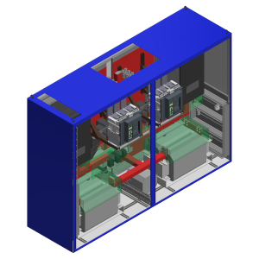
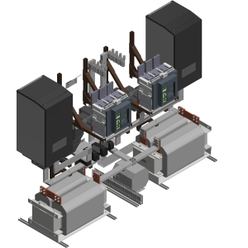
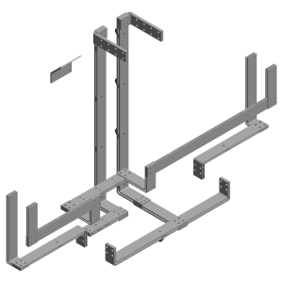
Design & Documentation
We design your control system to meet your unique needs and specifications. No matter which brand of controls you need, we have you covered.
We use a 3D design process to create cabinets with exact specifications and install controls right the first time. The result is a faster control system assembly time, and the ability to highlight issues before entering production. Our control cabinets are always custom-built to fit the required space and scalable for long-term flexibility.
Tightly integrated systems from the Bill of Material to final panel layouts.
Extensive AutoCAD, AutoCAD Electrical, EPLAN, Inventory and Solid Works Libraries
Easily adapted to support customer standards and formats
  Customer title block
  Existing wire numbers on retrofits

Slide 32
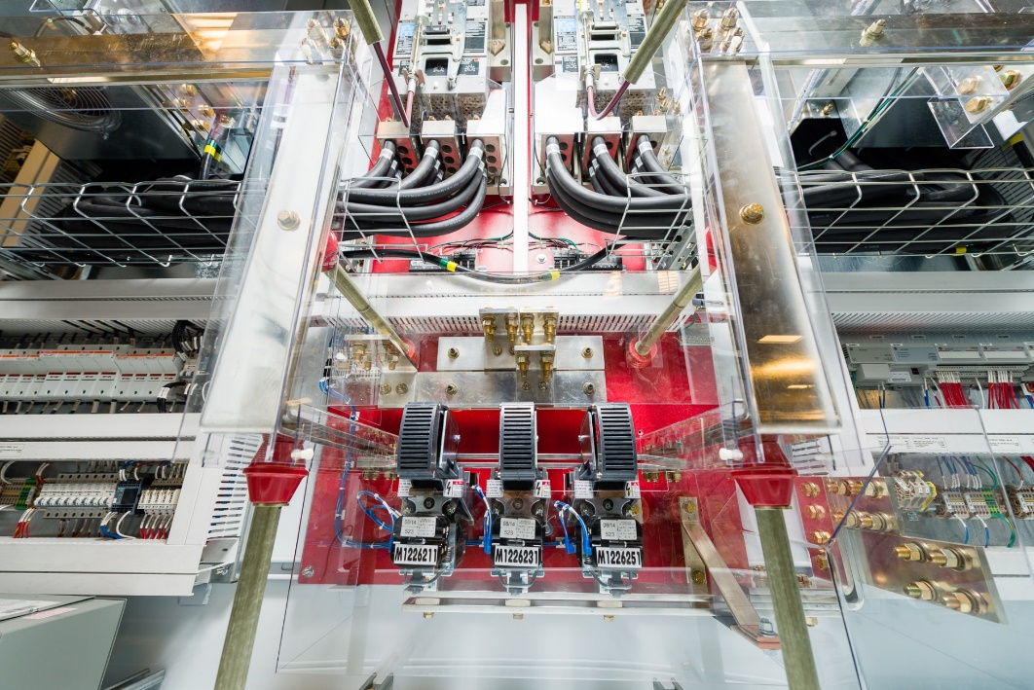
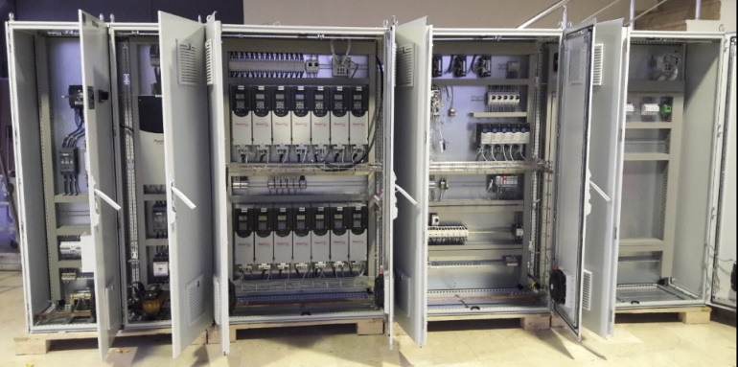
Manufacturing
Quad Plus can provide standard and custom-built cabinets.
Our cabinets are designed to fit the required space and are scalable for long-term flexibility.
We engineer the cabinets for Hazardous and Non-Hazardous environments. We engineer our cabinets to take into account many elements, including:
  Climate & Temperature
  Indoors/Outdoors
  Altitude
  Humidity
  Light to Extreme Duty
We offer standalone and Multi-bay systems.
System builds to UL 508A, UL698A, UL 1203 & CE.
Quad Plus has a CNC Machine in our shop to ensure an accurate and timely product.

Slide 33



E-House / PDC
E-Houses (Power Distribution Container) greatly reduce the customer’s downtime and increase the customer’s floorplan flexibility. They are built and fully tested at our facility.
  Flexible Design
  Container Type or Purpose Built
  Customized to fit location, great with space limitations
  Sub Floor or Raised Tray Design
  HVAC
  Alarm and Fire Suppression Systems are available

Slide 34


System Tested Prior To Shipment
Quad Plus tests the system at our facility for all communications and configuration. This practice reduces our customer’s downtime once their machine is shutdown. It saves significant time and money for our customer.
  The engineers that designed the system also test the system at our site.
  Systems fully configured and tested prior to shipment
  Customer FAT and SAT testing available
  Extensive system testing reduces startup time

Slide 35

Commissioning & On-going System Support
Quad Plus provides hands-on, onsite support during the startup process of your integrated system. The original project design engineers will ensure the transition from installation to production is smooth. We have a saying: whoever designs it starts it up.
Our goal is to have the most efficient startup to exceed your expectations of the newly integrated system.
  It starts with a comprehensive in-house system test to make certain the hardware, communications, and software configurations are in order.
  We will then start and optimize your newly supplied system to confirm that it meets your production requirements.
  We can provide electrical or mechanical installation supervision when required.
  Lastly, there is the pass-off to production, which may include production trials when applicable.
On-going System Support
  Field Service
  Remote Support & Troubleshooting

Slide 36

                Retrofits
When obsolete, unrepairable, or uneconomical components mandate upgrades, we evaluate your assets to provide retrofit options for restoring reliability, returning your operations to profitability, and adding new features; often while avoiding the need to replace your equipment entirely.
Quad Plus has extensive experience with supporting the processes, hardware, and programming of legacy equipment integrated with older systems that have failed or become unreliable.
We offer a complete solution that can be implemented in phases to minimize downtime and reduce interruption of your production schedules.

Slide 37
                Retrofits / Brands
Retrofitting new “state-of-the-art” equipment on existing machines presents an attractive, viable, alternative to maximize value and stretch the overall budget. Quad Plus has experienced engineers that can help with these brands and more.
Siemens AC Drives
6SE20 / 6SE21 Simovert P
6SE31 / 6SE32 Micromaster
6SE70 / Simovert Masterdrive
6SE64 / MM4 / Micromaster
GTO Phase Modules (Traction Systems)
Relcon 6SE85
Siemens DC Drives
6RA21 Simoreg Compact Converter
6RA22 / A1-106 / Simoreg 3rd gen
6RA23
6RA24 / A1-116 / Simoreg 4th gen
6RA70 / A1-126 / Simoreg 5th gen
Simoreg K
Siemens Softstarts & Elevator Starters
3RW34 / 3RW35
3RW40 / 3RW44
3RW5*
787AF** (elevator)
72**34AFP (elevator)
Siemens Texas Instruments
Simatic TI 505./ 555
TI 405
S7 95 / 100 / 115 / 135 / 155
Rockwell / Allen Bradley
1395DC Drive
1397 DC Drive
1336 AC Drive
1336 Force AC Drive
1336 Plus AC Drive
1336 Plus II AC Drive
1336 Impact AC Drive
PowerFlex 40 AC Drive
PowerFlex 400 AC Drive
PowerFlex 700 AC Drive
PowerFlex700S AC Drive
Ultra 100 Servo Drive
Ultra 200 Servo Drive
Ultra 3000 Servo Drive
ABB
ACS50 AC Drive
ACS100 AC Drive
ACS140 AC Drive
ACS160 AC Drive
ACS200 AC Drive
ACS300 AC Drive
ACS350 AC Drive
ACS400 AC Drive
ACS501 AC Drive
ACS502 AC Drive
ACS504 AC Drive
ACS506 AC Drive
ACS601 AC Drive
ACS604 AC Drive
ACS607 AC Drive
ACS624 AC Drive
ACS627 AC Drive
ACV700 AC Drive
SAMI Star AC Drive
Eurotherm / SSD
506 DC Drive
507 DC Drive
508 DC Drive
512C DC Drive
514C DC Drive
584SV AC Drive
590 DC Drive
590+ DC Drive
620L AC Drive
650 AC Drive
650S AC Drive
650V AC Drive
690+ AC Drive
890PX AC Drive
General Electric
Siltron DC Drive
VeeArc AC & DC
drives
Fanuc drives
Allen Bradley PLC
SLC 500
PLC-2
PLC-5
Reliance
FlexPak 3000
FlexPak Plus
GV3000 AC Drive
SD3000 AC Drive
SF3000 AC Drive
AutoMax
Max Pak Plus

Slide 38

Web Gauging
Quad Plus web gauging systems provide online thickness measurement to reduce variances of your flat products and materials during production.
Our state-of-the-art web gauging scanner technology can seamlessly integrate into your existing control system and production line.
We help you:
Determine the correct technology
Configure the frame for optimal performance
Install the web gauging sensors
Train the operators
Provide ongoing support
Our systems are a full turnkey solution with minimal downtime.

Slide 39

Web Gauging
Our team of technology experts has both machine and process knowledge, which allows them to recommend the optimal web gauging technology for your application.
Our team will partner with you from the beginning and will support the system after installation, giving you peace of mind that your new web gauging system will run properly.
Web Gauging System Solutions:
Custom Scanning Frames
Web Gauging Sensor Technology
Software and Reporting
Web Gauging System Advantages
Premium Installation and Support

Slide 40

Operations to Enterprise
Operation to Enterprise (O2E)
The Quad Plus team is ready to ensure critical systems are secure and put you in control of your operations. We can help you integrate from your shop floor to your Enterprise Resource Planning System via secure operational technology.
O2E creates a smart centralization system that rolls up data for analysis and manages common data without compromising production facility autonomous capability.
Operational Technology (OT) Infrastructure
Cybersecurity
Power of Virtual Architecture
OT Network
SCADA/HMI

Slide 41
Operations to Enterprise
O2E Managed Services
  Cybersecurity
  Backup and Disaster Recovery
  Firewall and End Point
  Resource Monitoring
  Asset Management
  Patching with Knowledge OT
  Multifactor Authentication (MFA)
  Cybersecurity Training
  Password Manager
  Domain Management
Existing/New Projects which can be enhanced
  SCADA/HMI Projects
  Multiple Plant Projects
  Large Scale Controls Projects
  Networking and Segmentation Projects
What We Do
  Systems Integration (ERP’s, CMMS, Recipe)
  Replace existing systems
    Integrate functionality into Enterprise Level SCADA
    Smart Centralization
  Install/Replace Secure OT Network
    Interfacing large machines
    2-way Data Management
  Install/Replace Hardware with Virtual Architecture
  Data Collection, Reporting and Trending
  HMI
  Cybersecurity and Network Consulting
  Database Tuning
  Implement Backup and Disaster Recovery

Slide 42

Systems Sales Support
Illinois
John Crosetto
Bob Flynn
Julio Lemus
Mel Carr
Scott Wolz
Eric Clinge
John Halpin
Collin Sleeman
Tom Miller
Ohio
Kate Burkett
Wisconsin/Minnesota
Adam Kahler
John Halpin
Georgia
Richard Cook
Arizona
Ron Malcolm
Texas
John Fischer
Ed Giles
Matti Paaso
New England Area
Boris Sherman

Slide 43
Some of Our Key Industrial Markets
Building Products
Vertical Manager: John Crosetto
  Rolled Roofing
  Tank Farms (Process)
  Shingles
  Fiber Cement Siding
  TPO Roofing
Converting
Vertical Manager: Bob Flynn
  Adhesive & Silicone Coating
  Laminating and Embossing
  Film Extrusion
  Blown Film
  Paper, Film & Foil Slitting
  Winders
Rubber & Tire
Vertical Manager: Richard Cook
  Extrusion
  Calender
  Textile & Steel
  Skiver
  Winders
  Compounding & Mixing Systems
Pulp & Paper
Vertical Manager: Richard Cook
  Sectional Paper Machines
  Re-winders
  Calenders
  Roll Wrappers and Packaging
  Dryer Steam Control

Slide 44
Some of Our Key Industrial Markets
Metals
Vertical Managers: John Crosetto & Ron Malcolm
  Tube & Pipe Mills
  Slitting Lines
  CTL & Blanking Lines
  Paint Lines
  Cold Mills
  Hot Mills
  Casters
  Rod & Bar Mills
  Oil, Gas & Marine
Vertical Manager: John Fischer
  Offshore & Land-based
  Top Drives
  Mud Pumps
  Generator Controls
  Electrification of Upstream Oilfield tools (Drilling, Production, etc.)
  Upstream Oilfield electrical power distribution (Mobile MV/LV SGWRs, Mobile XFMRs, etc.
  Electrification of deck winches, cable laying machinery
Cement & Mining
Vertical Managers: John Crosetto & Ron Malcolm
  Crushers
  Raw Mills
  Classifiers
  Ball Mills
  Rotary Kilns
  Conveyors
  Packers
Return to Services Page

Slide 45

In-House Distributor
QP Automation, based in Joliet, is a high-tech electrical distributor backed by Quad Plus engineering expertise. Unlike traditional distributors, we employ 30+ OEM-trained field engineers with licensed software to troubleshoot and support platforms, including Siemens and Rockwell Automation. With certified Siemens engineers, strategic manufacturer partnerships, and integrated e-commerce pricing, we deliver complete, turnkey solutions with exceptional customer support.
• High-tech electrical distributor with integrated engineering support
• 30+ OEM-trained engineers with licensed troubleshooting software
• Certified Siemens engineers and multi-platform automation expertise
• Strategic partnerships with Siemens, Leuze (Safety), Tosibox (Remote Access), and EM Energy & Building
• Full-service support model including e-commerce, pricing, sales, engineering, and turnkey solutions

Slide 46


In-House Distributor

Slide 47






In-House Distributor

Slide 48
Drives & Controls Repair
Industrial Circuit Breaker Repair
& Field Service
Return to Services Page

Slide 49

In-House Drive Repair and Field Service
Quad Plus technicians are manufacturer-trained, which gives us the ability to expertly diagnose issues with your drive system because of our experience with OEM manufacturers and exclusive access to original OEM documentation, including manuals, literature, and schematics.
  We inspect AC or DC Variable Frequency Drives (VFDs) for defects by using a complex series of tests and industrial application simulations.
  If we find any defects or any VFD unit specifications out of the manufacturer-specified tolerance range, we investigate and repair them.
  We then retest for function, and if the unit passes our comprehensive test procedures, we thoroughly clean the drive and get it back in service.
  We test every VFD unit by connecting it to a power-matched motor and dynamically loading it to verify the drive meets the current and torque requirements specified on the nameplate.
  After repairs are completed, each drive undergoes a comprehensive load stress test, where our expert technicians take detailed readings and perform advanced diagnostics to ensure it will operate safely, reliably, and at full performance once returned to production.

Slide 50

In-House Drive Repair and Field Service
DIFFERENTIATORS:
  Load Stress Test: To ensure it will perform adequately and safely once it is back in production.
  Manufacturer Trained: Our Technicians are manufacturer-trained
  Resources: An extensive library of manuals, guides, and schematics that gives us the advantage in repair.
  Life extension: We can often extend the Drive’s life 8-10 years. (As long as parts are available).
  Cost Reduction: We are a cost-effective alternative to replacement.
  Repair Time: We offer an expedited service that will guarantee that their Drive can be repaired in 2-3 business days, shortening downtime.
  Spare Parts Inventory: We carry a huge inventory of original spare parts that can be purchased by our customers.
  Legacy Work: We can repair and support legacy controls, drives, and parts that OEM manufacturers have stopped supporting.

Slide 51
Our Drive and Control Product Lines
Siemens AC & DC Drives
Siemens Softstarts & Elevator Starters
Control Techniques
EATON
Rockwell Automation
Toshiba
Hitachi
Emerson
Fuji
ABB
Control Techniques
Rockwell Automation
Allen-Bradley
WEG
Relcon
VeeArc
& Many Others

Slide 52


Circuit Breaker Repair Shop
Quad Plus is PEARL certified and follows strict reconditioning and refurbishment processes as defined by ANSI/IEEE C37.59. https://pearl1.org/
The Quad Plus process for circuit breaker repair has set the standard for the industry. We can repair, refurbish, and retrofit circuit breakers.
  We inspect each circuit breaker for worn or missing mechanisms.
  We perform electrical testing and analysis to determine any issues with the circuit breaker.
  Upon approval for repair, defective parts are removed and replaced with new parts.
  A final test and inspection are performed before the circuit breaker is returned.
We offer 24/7 emergency services along with rental circuit breakers to maintain the integrity of your operation.

Slide 53

Circuit Breaker Repair Shop
Quad Plus will use only OEM or manufacturer-recommended parts. We offer partial reconditioning that focuses only on problem areas or a complete teardown and rebuild of the breaker to return mature breakers into a “like new” condition.
Every OEM part replaced comes with a one-year warranty so you can be confident of your repaired parts.
We repair, but not limited to:
  Westinghouse
  GE
  Siemens
  Allis-Chalmers
  Square-D
  ITE
  Cutler-Hammer / EATON
  BBC/ABB
  McGraw Edison
Return to Services Page

Slide 54
Power Electronics Assembly

Slide 55

Power Electronics Assembly
Quad Plus has the infrastructure and technical expertise to procure, assemble and test power electronics. Our engineers can review the specifications and develop processes and procedures directly suited to each type of power electronics. Quad Plus is currently executing, among various other, the following Power Electronic Assembly projects:
Power cell hardening, assembly and testing
Converter repair, cleaning, reassembly and testing
Inverter repair, cleaning, reassembly and testing
Contract manufacture medium voltage specific VFD hardware for Oil & Gas processes for mobile applications
Contract manufacture medium voltage specific VFD hardware for a major OEM for mobile applications

Slide 56

Facilities & Capabilities
Quad Plus has a dedicated 18,000 square foot power electronics facility.
We have sixteen dedicated workbench areas for our trained engineers and technicians.
Each bench is an ESD controlled workstation.
  Continuous work mat & wrist strap monitoring
  Surface resistivity compliance verification
Each engineer and technician has their own equipment and access to the testing areas to handle a project to completion.
Testing Facilities
  120 Single Phase to 690 Three Phase available
  Medium voltage 4160, 12470 and 13800 currently available
  6 Pulse, 12 Pulse and 18 Pulse capability
  AC and DC Test Motors available
  Portable overhead crane (up to 2,000 lbs)
  Load Testing (Converters, Inverters, VFDs)

Slide 57


Power Electronics Assembly
Portable overhead crane (up to 2,000 lbs)
Load Testing (Converters, Inverters, VFDs)

Slide 58

Our Engineering Team
The Quad Plus engineering team has a proven history of designing, developing and improving upon electrical equipment, systems and processes. With more than twenty patents between our team, we continue to press the envelope of what technology can do.
Our Leads:
  Kent Wegley
  Al Corcoran
  Jeff Pollack
  Jon Vernon
  Herb Taylor
The Quad Plus engineering team excels in product research, product development and updates, quality control and promoting innovation.

Slide 59
Chicagoland Partners

Slide 60

ZENTEL TECH
At Zentel Tech, you can harness the full potential of your facility with a seamlessly designed project that perfectly meets your mechanical and HVAC needs. Our team of creative, solution-focused engineers is dedicated to surpassing your project’s specifications. Get the confidence and reliability you need, with consistent and precise results crafted through rigorous testing and commissioning.
Our Services
Mechanical and Process Piping
Plumbing & Plumbing Field Service
HVAC and Refrigeration
Controlled Environment Testing and Repair
Our Process
Expert Design and Engineering
Total Installation Solutions
Verification Excellence
Industries We Serve
Hospitals
Schools/Universities
Laboratories
Office Buildings
Data Centers
Power Houses
Central Plants
Through ingenuity and groundbreaking innovation, we help our customers experience the best performance from their mechanical systems.

Slide 61


Interactive Building Solutions
Interactive Building Solutions is committed to ensuring that your building has the best possible schemes, algorithms, programs, and settings to operate the building efficiently and comfortably. Over time, maintaining and enhancing the system can provide added features and benefits, better information, increased comfort, and energy savings.
As a general contractor, we play a crucial role on a construction project. We make sure it is properly planned, managed and executed. We ensure the project scope is correctly defined and budgeted while also identifying potential construction challenges and determine priorities.
Our Services
Licensed General Contractor
  Planning, Managing and Executing your Construction project
Building Controls & Critical Environments
  HVAC Controls and Building Automation Systems
  Precision Temperature and Humidity Control
Electrical Contractor
HVAC & DUCT, Test & Balance
Building Management/Operations
Critical Environment Temperature Design/Build

Slide 62
Interactive Building Solutions
CONTROLS
Building Automation Systems (BAS) once limited to climate control, now handle lighting, access control, and security.
BAS
Minimize operating costs and maximizing return on investment.
New Construction
Building Automaton systems work best they're an integral part of new construction. The cost of a BAS is extremely low relative to the overall construction cost. Benefits provide comfort, reduced building operation cost and energy savings.
Retrofits
Beginning with a comprehensive survey of your building and its system, we can get the most out of any legacy part that isn't worn out. IBS can provide flawless retrofits ad upgrades to your building's systems.
Products
We supply a variety of quality products lines including but not limited to Tridium, Johnson Controls and Honeywell.
CRITICAL ENVIRONMENTS
If you have a project that requires thinking outside-the-box, Interactive Building Solutions can help.
Laser Labs
Focus on your research and minimize environmental variables with very tight controls for your critical experiments.
Medical Centers
Critical pressurization, airflow, temperature, and humidification for operating suites and patient rooms.
Universities
Ensure a safe environment for your research labs, meeting Biological Safety Level 3 criteria.
Data Centers
Rely on our sustainability and dependability for critical equipment
Precise temperature and humidity control for highly sensitive electronic equipment.
And More!
Meeting your unique needs across a variety of industries – food processing, libraries, museums, zoos, retail & more.

Slide 63
Interactive Building Solutions
ELECTRICAL
Interactive Building Solutions specializes in commercial, schools, industrial and residential electrical systems:
Distribution
Lighting
Lighting Controls
Fire Alarm
Telecommunication
Security
Audio Visual
Sound/Paging Systems
Healthcare system
UPS Systems
Temperature controls
NETA Testing
Power System Testing
Bonding capability to $50,000,000.
VARIABLE FREQUENCY DRIVES (VFDS)
Service
IBS field service technicians can come to your building to repair and service your pumps and HVAC variable frequency drives (VFD).
Repair
IBS is the premier VFD repair center in the Chicagoland area. Our technicians are manufacturer-trained and ready to repair or refurbish your product with original spare parts and manufacturer test equipment and specifications.
New VFDs
IBS can replace your VFD with the same model or suggest alternatives. We can offer ideas for reusing existing bypass equipment or reduced voltage starters to save you money.
VFD Service Agreements
IBS can visit your site one or more times a year to perform cleaning and other maintenance on your VFDs This is particularly useful for larger drives that would be difficult and expensive to replace and it is a good value even for smaller drives because it allows you to get the full life expectancy out of the drive and avoid unexpected VFD failures.
Manufacturers
We service, repair and supply quality drives by ABB, Weg, Danfoss, Yaskawa, Toshiba, Allen Bradley and many more.

Slide 64
The Quad Plus Difference
Entire Lifecycle
Whether you have a new automation system build, need to upgrade your current system, or retrofit an outdated system, our team of expert engineers can meet your needs.
Remote Support & Diagnostics
Most issues can be fixed quickly via our secure remote support system. If the technicians are not able to resolve the issue, remotely, they will be prepped with the tools and equipment they need to resolve the issue when they come onsite.
Turnkey Solutions
Our system integration team will partner with you and manage your entire project from beginning to end and beyond. Our goal is to make the process as smooth as possible for you.
3D Design and Packaging
At Quad Plus, our team uses 3D modeling to virtually design cabinets and control layouts. This allows you to see where the cabinet will be located and make alterations before anything is built, which saves you time
Industry Experts
Our engineers know your control systems because they have worked in the industries they support. They also received additional training, certifications, and have access to specialized manufacturer resources.
Value Add
Installing a system is only one part of what we do; we perform every aspect of control system integration. With years of experience in many industries, not only do our controls do the task required, but our multi-system process knowledge that goes into system designs is second to none.
Thank you!

